Slide 1
PROMOTING
YOUTH EMPLOYMENT IN REMOTE AREAS IN JORDAN / JOB-JO
Prof.Omer Maaitah

Slide 2
https://www.mutah.edu.jo/job-jo/index.html
https://www.facebook.com/Job-Jo-678959875866429

Slide 3
About the Job-Jo project
Job Jo is aiming to reduce unemployment and poverty in remote areas in Jordan through the establishment of multiple Business Bureaus in the participating higher education institutions. These Bureaus will provide the necessary teaching and training services for unemployed graduates and re-qualify them to increase their job opportunities. Job Jo also claims to have a special focus on women. The foreseen outcomes will effectively contribute to improving the capacity building process at the national level and to allow graduates to gain the skills and training needed for their profession.

Slide 4
Cont.
Moreover, the foreseen activities will surely foster economic growth and reduce unemployment and poverty in remote areas. Job Jo aims include providing services and workshops to graduates to gain skills which are necessary, but not commonly provided by universities. In addition, Job Jo will promote the modernization of learning methods, training of staff and students, management and quality control and internationalization of higher education institutions. The priority addressed is a relevant national priority for the Jordan

Slide 5
Objectives
1. Establishment regional Business Service Network Bureau (BSNB) to promote employment in the provinces of Karak, Tafila, Maan, Aqaba and Irbid.
2. Development of training courses in the BSNB based on the experience exchange with the EU.
3-Producing training material
4. Adapting job creation instruments to the needs of young people in remote areas.

Slide 6
Cont.
5. Supporting initiatives designed to enhance the employability of young people in the region.
6. Creating employment opportunities by supporting entrepreneurship.
7. Lesson Learned from the European partners to include their cooperation with non‐academic partners.

Slide 7
Cont.
8. Establishing Network Service between the Universities, Industries, and Public and Private Sectors.
9. Promote the relationship between the Jordanian Institutions with EUs.
10. Students and staff from JO partners will receive training in EU

Slide 8
How the project objectives will be achieved?
Establish Business Service Network Bureau inside academic institutions and prepare it to receive the necessary equipment provided within the framework of this project.
Conduct training that focuses on methods of teaching and development of the methodological foundation for the trainers assigned in these Bureaus.

Slide 9
Cont.
Establish a website for the project so that all activities, chances, and events of the project will be available to everyone.
The target group of the project(trainees) will receive Employability Skills so they can have the opportunity to enhance their employability.

Slide 10
Areas that the training will focus on
Courses on Personal Skills Development like communication skills.
Training on job preparation to equip unemployment people with advanced job-hunting skills, career development, interview skills and the opportunity to participate in Industry Awareness Experiences.

Slide 11
Impact and sustainability
1-The project demonstrates that it will have an impact on aspects related to employment, poverty and internationalization in the network to be established among the participating higher education institutions. In this regard, three main elements are identified, namely:
    the establishment of career centres.
    capacity building of the partners’ staff and students and
    improving the relationships between Jordanian and EU partners.
2- This is important in terms of the development and tailoring of concept modules as part of a new approach to encourage employment and reduce poverty.

Slide 12
3- The project suggests a clear and efficient dissemination plan during the lifetime of the project. The work package devoted to dissemination includes several concrete activities, including the use of information materials, a website platform, an operative network, social media, annual meetings, workshops, public events, press, publications and conferences; however, information provided about how these means will be implemented needs further elaboration in the work plan and in the Logical Framework Matrix. Overall, the dissemination plans at the national and international level are good and aim to reach all the identified target groups.

Slide 13
4- The project suggests an appropriate approach to guarantee the dissemination process beyond the lifetime of the project into mainstream Jordanian higher education programmers. It also indicates how the Partner Country institutions, through their established career centers, will deal with the issue of employment and poverty in the future. The career centers, the trained staff, the continuous preparation of teaching and training material, the cooperation with non-academic partners and the website, will support the sustainability of the project. However, while all these actions are essential, no particular explanation is given regarding how they will generate the necessary sustainable development of the established programme.

Slide 14
The trainings and material will be structured on following areas:
(A)-Training Courses on Personal and Communication Skills Development. It helps them to set goals in their life to maximize their potential. They will be guided to identify the skills they need to enhance their employability prospects, raise their confidence, and lead to fulfilling higher quality life. Extensive focus will be on the communication skills.
(B)-Training on job preparation to equip unemployment people with advanced job hunting skills and career development. These experiences will provide the people with an insight into the tasks and duties of different industries.
(C)- Training course on interview skills and the opportunity to participate in Industry Awareness Experiences and to enhance of persuading
(D)-Global citizenship education and civil behaviour- Critical Thinking in Solving Problems and New Ideas

Slide 15




Project Partners
Partner number & Logo | Partner name
P1 | Mutah University (MU)
P2 | Tafila Technical University (TTU)
P3 | Al Hussein Bin Talal University (AHU)
P4 | The Ministry of Public Works and Housing (MPWH)

Slide 16




Project Partners
Partner number & Logo | Partner name
P5 | Grator Alkarak Manicipality(GKM)
P6 | Leipzig University of Applied Sciences (HTWK)
P7 | University of Cyprus – UCY
P8 | Instituto Superior de Leiria, Sociedade Unipessoal, Lda. (ISLA)

Slide 17



Project Partners
Partner number & Logo | Partner name
P9 | Int@E UG
P10 | Jordan University of Science and Technology (JUST)
P11 | University of Jordan (UJ)

Slide 18
Work Packages of the project
Preparation(WP1): Start up activities
1.1 Networking and list of Stakeholder Members.
1.2 Kick off meeting.
1.3 Questionnaire study including local. community.
1.4 Analysis the study.
WP Leader: JUST

Slide 19
Development(WP2): Establishing Business Network Bureau.
2.1 Scoping and Market Needs Analysis.
2.2 Purchasing equipment, Installation and preparation the Bureau.
2.3 Training to study of the experience of European.
WP leader KHWT

Slide 20
Development(WP3): Organization the Activity of the Bureau
3.1. Training of Trainers of the Career Centers,
3.2. Development of methodical base for training,
3.3. Training activity,
3.4. Creation and updating JOB-JO Web site and database,
3.5. Creation of network model
WP3 Leader: UCY

Slide 21
Quality(WP4): Quality assurance
4.1 Quality Committee.
4.2 External Evaluation.
4.3 Monitoring and Evaluation Plan.
4.4 Reports (Reports of Monitoring Committee).
WP4 Leader: ISLA

Slide 22
Dissemination & Exploration(WP5)
5.1. Dissemination of project activity and its results: presentations, workshops, events.
5.2. Participation in regional Labour Fairs.
5.3. Carrying out Conference and info days.
WP5 Leader: UJ

Slide 23
How the Questionnaire Prepared
1-Stakhoder session during the Kick off meeting
2-Interview many people
3-Asking the student during
4-discussion with JO partners
5-reading literature (previous studies)
6-discussion through social media

Slide 24
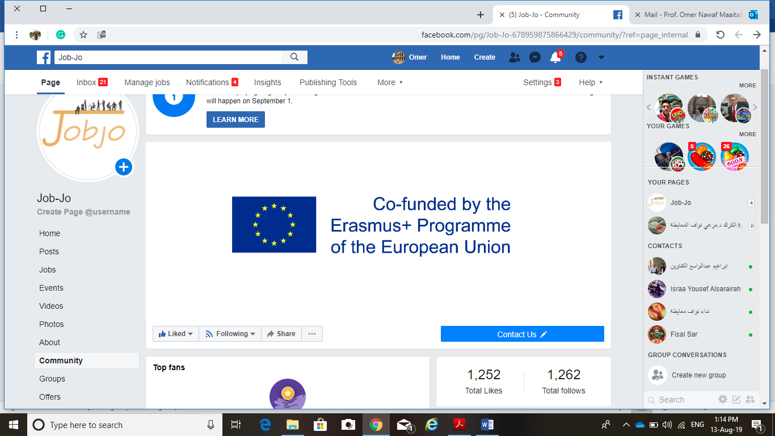

Slide 25
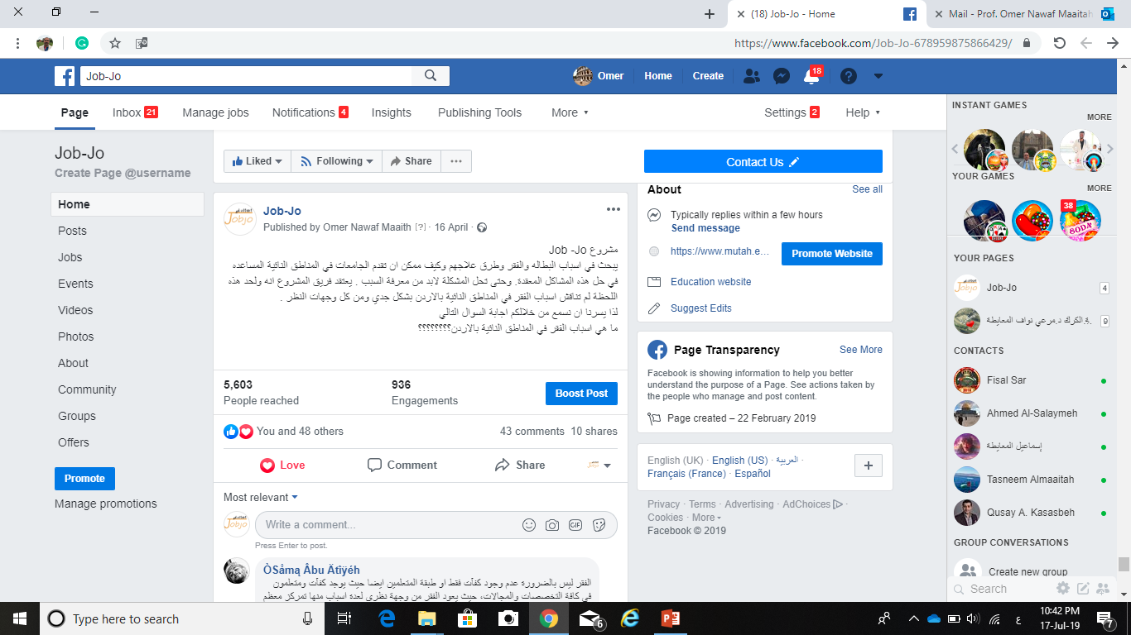
How the Questionnaire Prepared

Slide 26
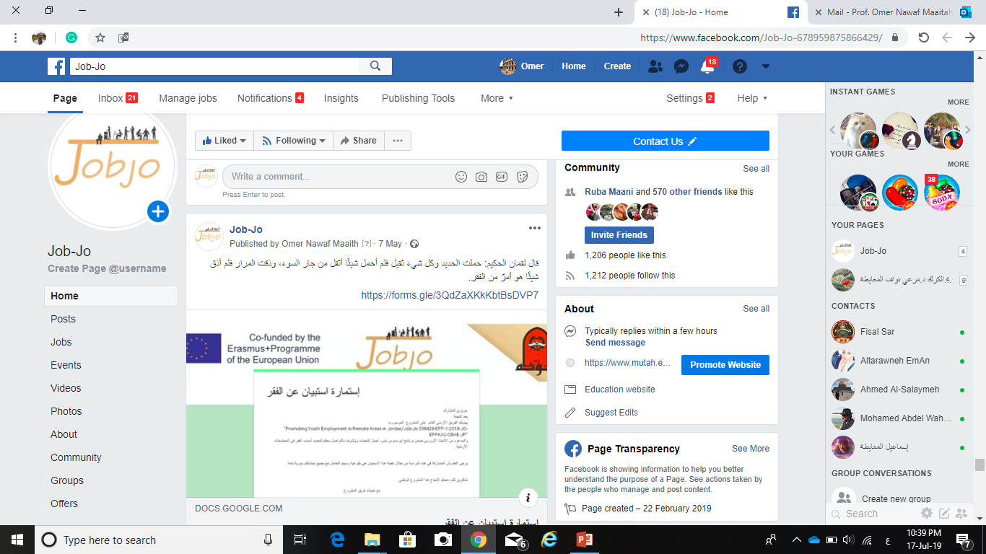
How the Questionnaire Prepared

Slide 27
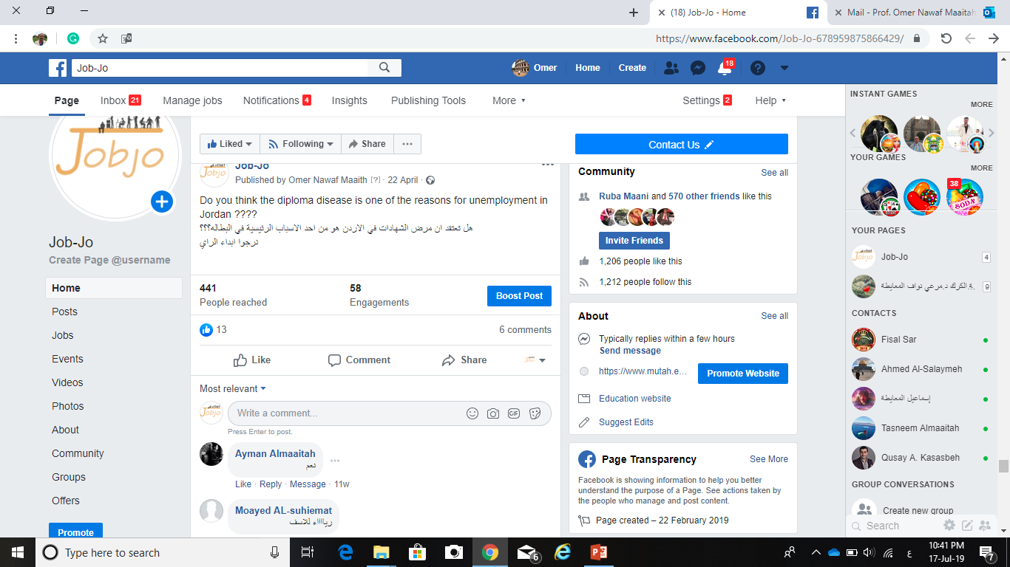

Slide 28
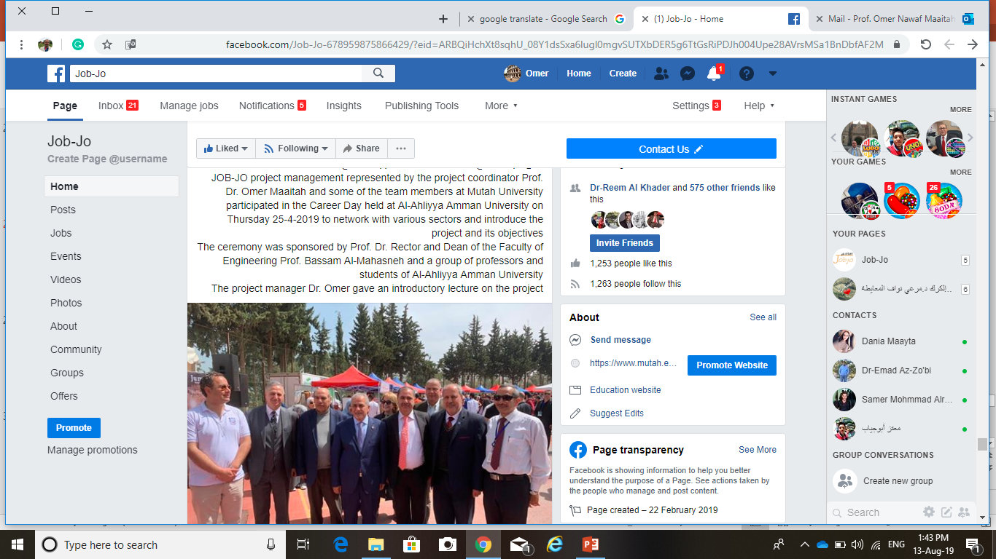

Slide 29
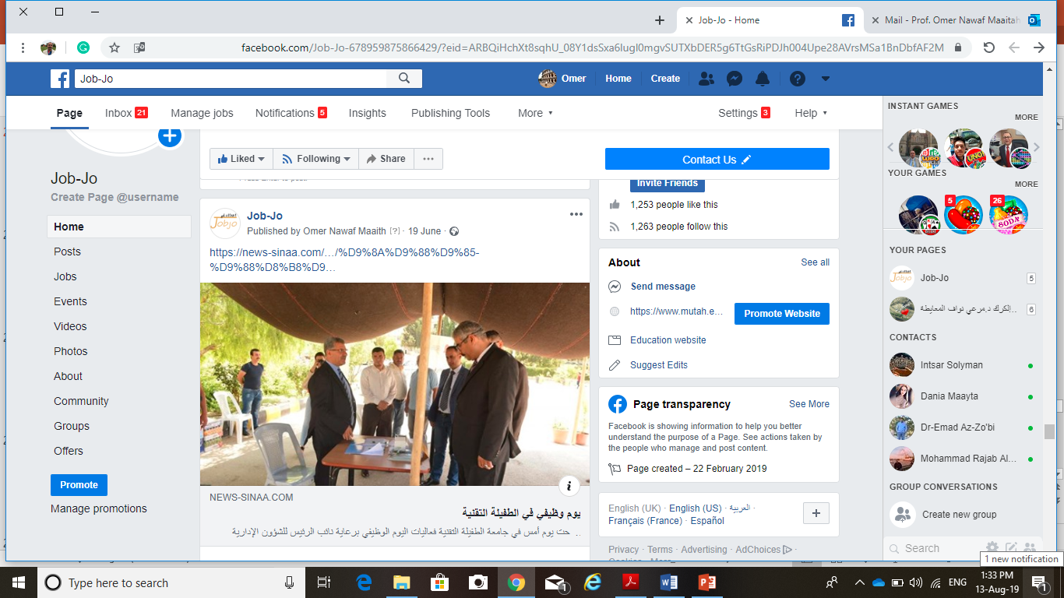

Slide 31
THANK
YOU

